Slide 1
计算机图形学
Computer Graphics
授课班级：111161-2班
任课教师：罗忠文
E-mail：24035234@qq.com
主页：se.cug.edu.cn

Slide 2
内容
变换概述
变换的类型
变换的表示
变换的复合
趣味变换：迭代函数系统IFS
难点: 变换法向量

Slide 3


趣玩: 迭代函数系统（IFS）
分形（fractal）的例子
使用一组线性变换f_{i}来呈现自相似性

Slide 4
趣玩: 迭代函数系统(IFS)
收缩
吸引子是一个固定点

Slide 5
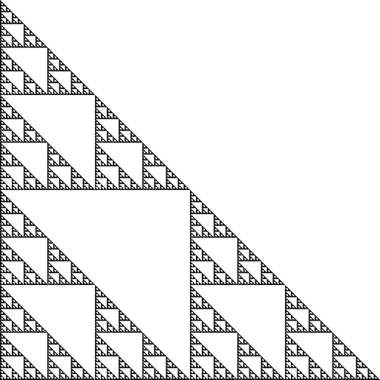
例: Sierpinski三角
由一组 n 个仿射变换来描述
  此处, n = 3
  平移及缩放0.5

Slide 6
例: Sierpinski 三角
for “lots” of random input points (x₀, y₀)
  for j=0 to num_iters
    randomly pick transformation i
      (x_{k+1}, y_{k+1}) = f_{i} (x_{k}, y_{k})
  display (x_{k}, y_{k})

Slide 7
例: Sierpinski 三角
for “lots” of random input points (x₀, y₀)
  for j=0 to num_iters
    randomly pick transformation i
      (x_{k+1}, y_{k+1}) = f_{i} (x_{k}, y_{k})
  display (x_{k}, y_{k})

Slide 8
例: Sierpinski 三角
for “lots” of random input points (x₀, y₀)
  for j=0 to num_iters
    randomly pick transformation i
      (x_{k+1}, y_{k+1}) = f_{i} (x_{k}, y_{k})
  display (x_{k}, y_{k})

Slide 9
例: Sierpinski 三角
for “lots” of random input points (x₀, y₀)
  for j=0 to num_iters
    randomly pick transformation i
      (x_{k+1}, y_{k+1}) = f_{i} (x_{k}, y_{k})
  display (x_{k}, y_{k})

Slide 10
例: Sierpinski 三角
for “lots” of random input points (x₀, y₀)
  for j=0 to num_iters
    randomly pick transformation i
      (x_{k+1}, y_{k+1}) = f_{i} (x_{k}, y_{k})
  display (x_{k}, y_{k})

Slide 11
例: Sierpinski 三角
for “lots” of random input points (x₀, y₀)
  for j=0 to num_iters
    randomly pick transformation i
      (x_{k+1}, y_{k+1}) = f_{i} (x_{k}, y_{k})
  display (x_{k}, y_{k})

Slide 12
例: Sierpinski 三角
for “lots” of random input points (x₀, y₀)
  for j=0 to num_iters
    randomly pick transformation i
      (x_{k+1}, y_{k+1}) = f_{i} (x_{k}, y_{k})
  display (x_{k}, y_{k})

Slide 13
例: Sierpinski 三角
for “lots” of random input points (x₀, y₀)
  for j=0 to num_iters
    randomly pick transformation i
      (x_{k+1}, y_{k+1}) = f_{i} (x_{k}, y_{k})
  display (x_{k}, y_{k})

Slide 14
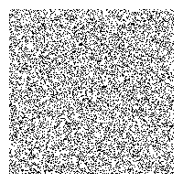
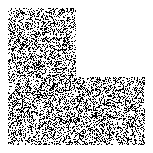

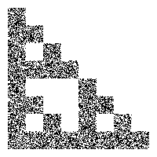
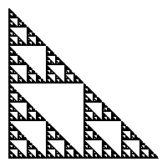
例: Sierpinski 三角
for “lots” of random input points (x₀, y₀)
  for j=0 to num_iters
    randomly pick transformation i
      (x_{k+1}, y_{k+1}) = f_{i} (x_{k}, y_{k})
  display (x_{k}, y_{k})
增加迭代次数

Slide 15
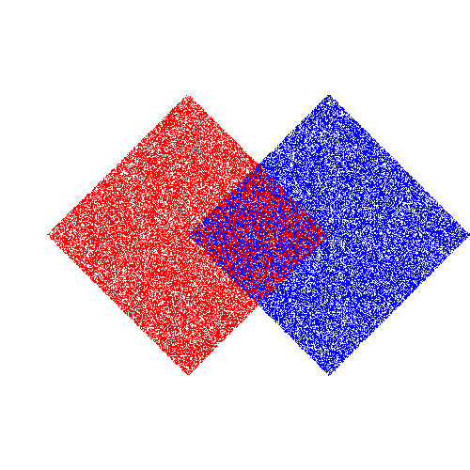
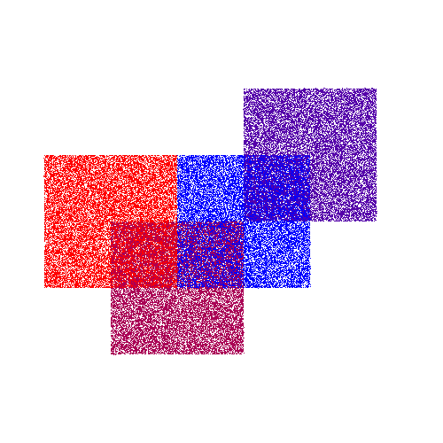
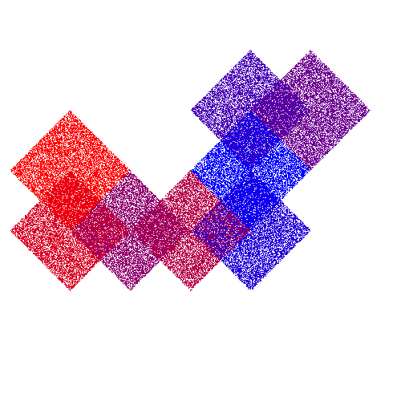
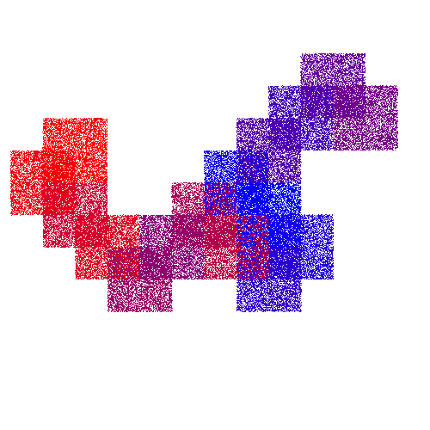
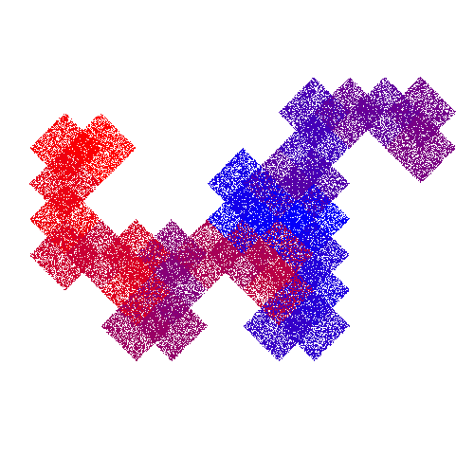
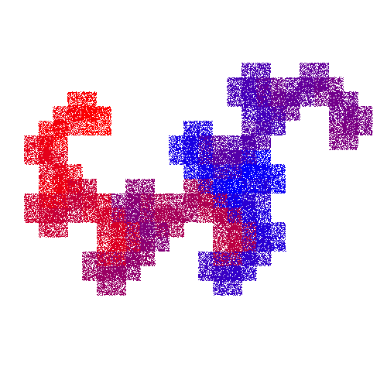
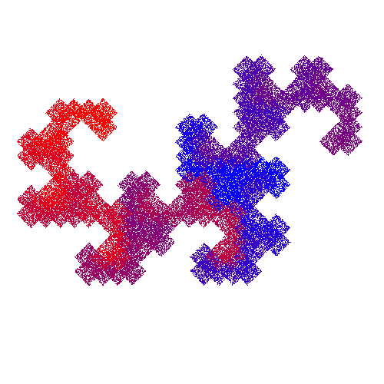
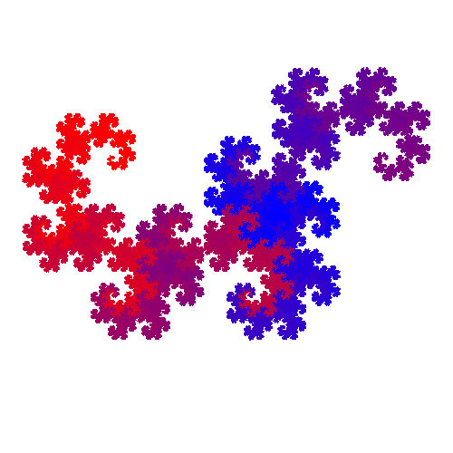
另一个IFS: 龙（Dragon）

Slide 16
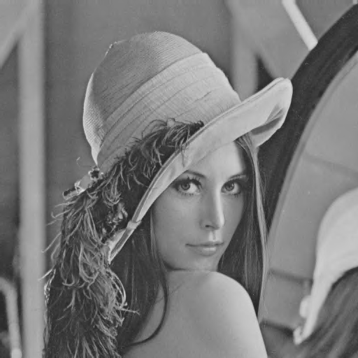

应用: 分形压缩
发掘图像中的自相似性
使用Fractal Photo Lab压缩

Slide 17
提问?

